Slide 1
Machine Learning Approach for Early Identification of Dyslexia In Children
21251A0521-P.Sathwika
21251A0542-G.Manaswini
21251A0565-P.Varsha
22255A0501-K.Samhita
Mentor
K.Sindhura Asst.Proff

Slide 2
Table Of Contents
Introduction
Existing System
Problem Statement
Drawbacks
Proposed Solution
Objectives
Methodology
Modules
Result

Slide 3
Introduction
The project prioritizes early identification using advanced screening tools and machine learning algorithms to detect dyslexia symptoms promptly.
Early detection facilitates timely support, empowering educators, healthcare professionals, and parents to implement targeted interventions.
By addressing reading and writing difficulties early on, the project aims to enhance academic outcomes and promote self-confidence among individuals with dyslexia.

Slide 4
Existing Systems
Traditional assessment methods and manual screening tools are subjective and time-consuming, leading to delayed intervention.
Previous studies have utilized machine learning models to predict the risk of dyslexia, achieving varying levels of accuracy.

Slide 5
Problem Statement
Early identification of dyslexia using machine learning algorithms can pave the way for customized interventions, enabling individuals with dyslexia to thrive academically, professionally, and socially.
Justification
Machine learning enables early identification of dyslexia, facilitating timely and customized interventions tailored to individual needs and learning styles. These interventions support academic success by addressing specific challenges like reading and spelling, leading to improved professional opportunities and enhanced social functioning. Furthermore, early intervention reduces stigma, empowering individuals with dyslexia to embrace their strengths and achieve greater acceptance and inclusion in society.

Slide 6
Drawbacks
Limited accuracy and scalability of existing predictive models.
Reliance on manual screening tools and subjective assessments.
Limited access to resources and expertise hampers the widespread adoption and scalability of machine learning systems for dyslexia prediction.
Existing dyslexia prediction models often exhibit limited accuracy due to factors like biased training data, inadequate features, or the complexity of dyslexia, resulting in potential misdiagnoses.

Slide 7
Proposed Solution
Develop an effective machine learning model to predict the likelihood of dyslexia in children based on linguistic, cognitive,syllabel audio, and visual discrimination.
Employ a comparative analysis of various classification algorithms to identify the best-performing model.

Slide 8
Objectives
Develop a machine learning model capable of accurately predicting the risk of dyslexia in children.
Evaluate and compare the performance of different classification algorithms.
Create an easy-to-use tool for early identification of dyslexia in children, aiding in timely intervention and support.

Slide 9
Methodology
Collect a diverse dataset comprising linguistic, cognitive, audio, and visual data relevant to dyslexia
Clean the data by handling missing values and removing noise, then normalize and encode features to prepare for model training.
Extract meaningful features through statistical analysis and domain knowledge to enhance the model's ability to identify patterns associated with dyslexia.
Train and optimize various machine learning models (Random Forest, Decision Tree, SVM, AdaBoost) using hyperparameter tuning.
Evaluate models using metrics accuracy, precision, recall, and F1-score, and compare results to select the best-performing algorithm.

Slide 10
Flow Diagram
Collection of data
Pre Processing
Feature Scaling
Apply Algorithms
User Interface Development
Model Evaluation
Model Training
Select the best fit algorithm

Slide 11
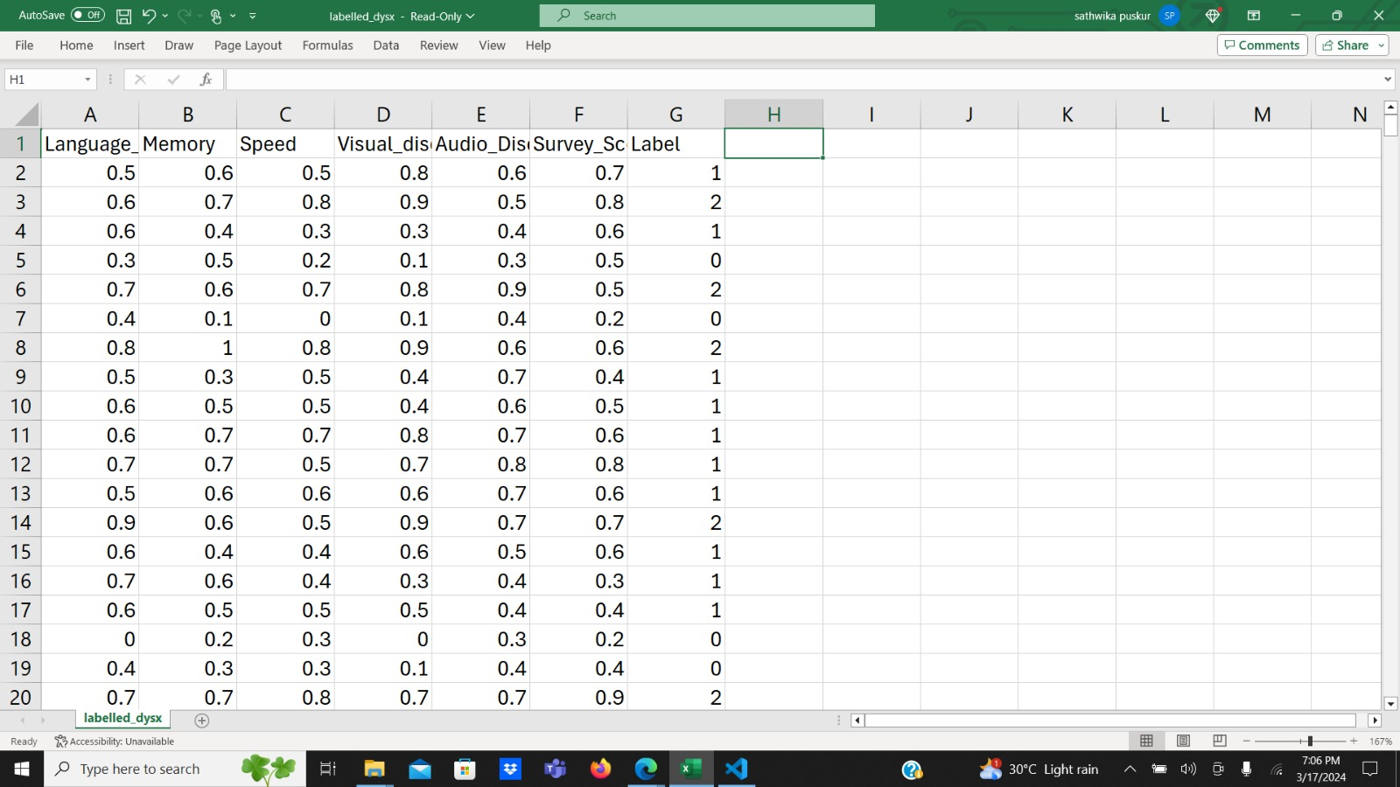

Slide 12
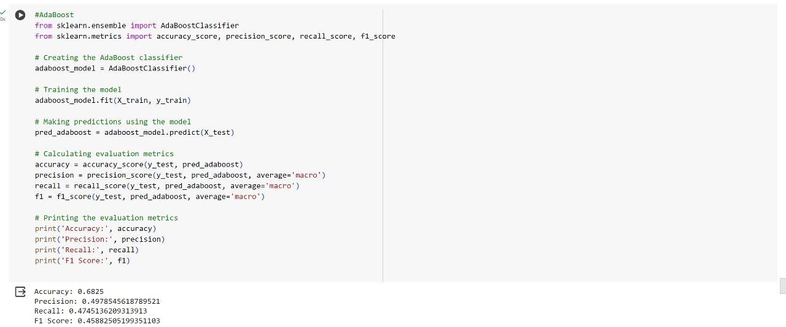
AdaBoost

Slide 13
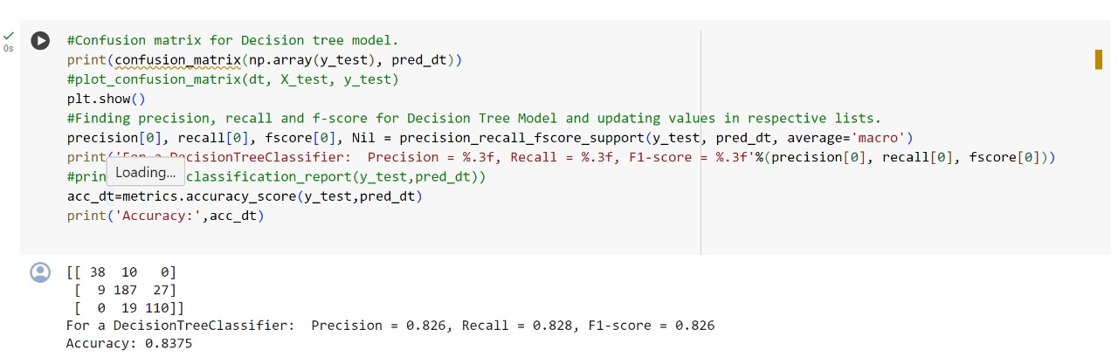
Using Decision Tree Model

Slide 14
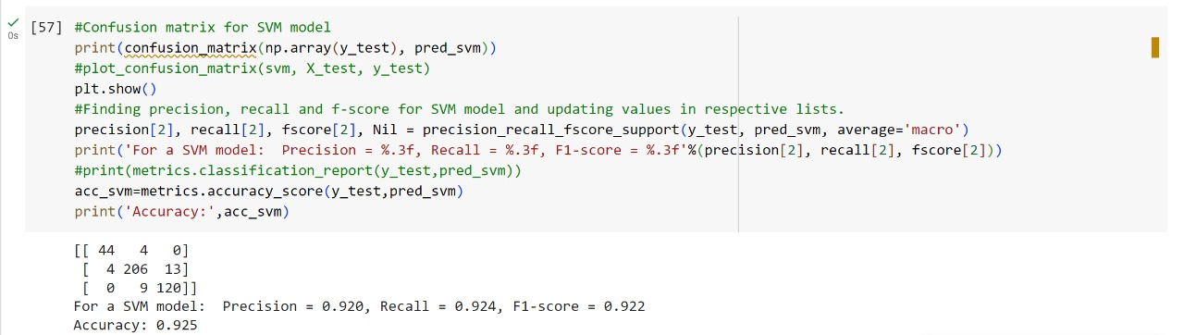
Using SVM Model

Slide 15
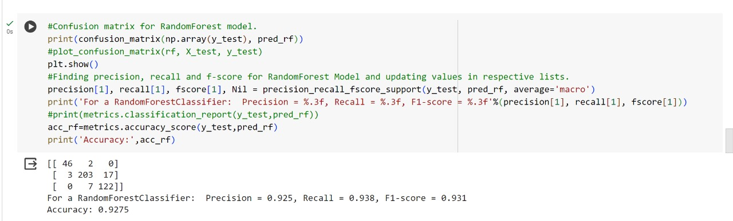
Random Forest

Slide 16
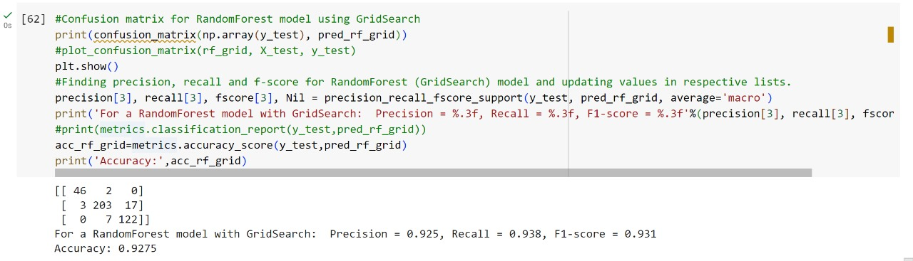
Using RandomForest - GridSearch Model

Slide 17


Slide 18
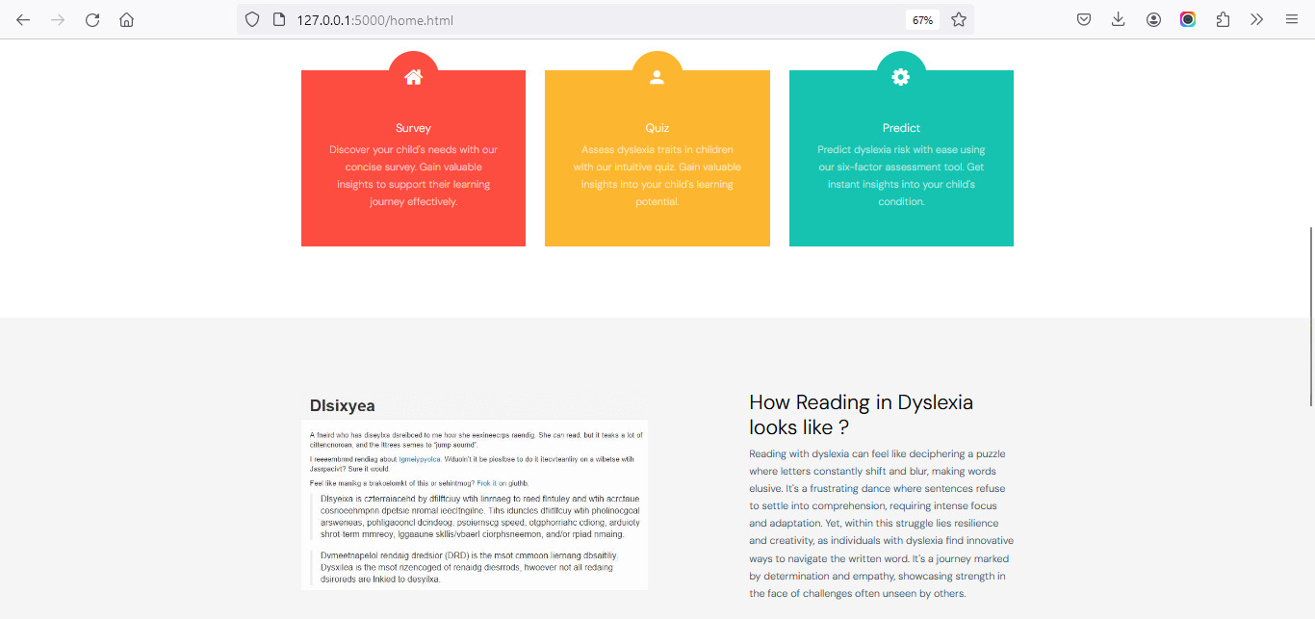

Slide 19
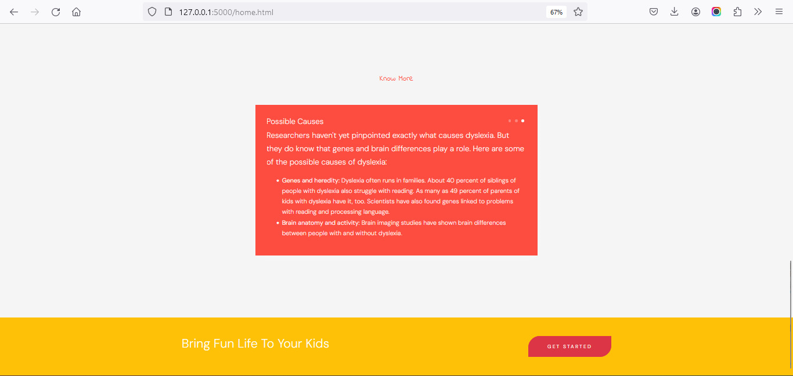

Slide 20


Slide 21
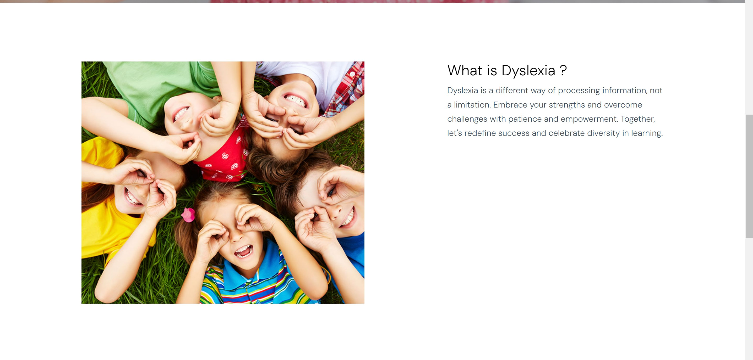

Slide 22
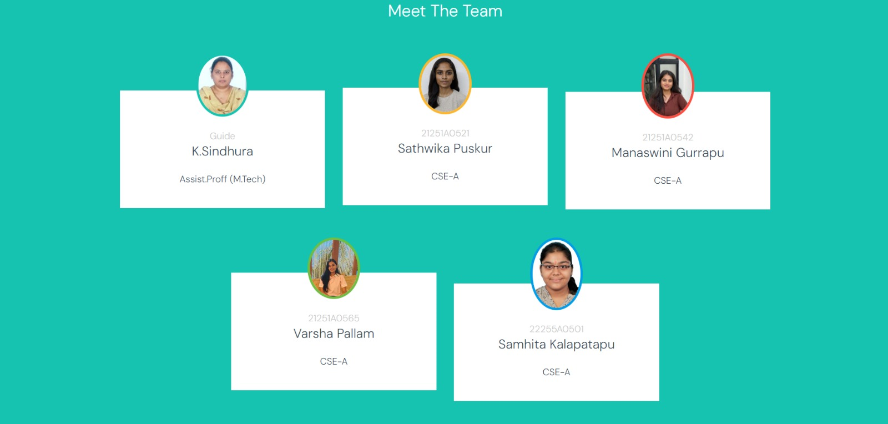

Slide 23


Slide 24
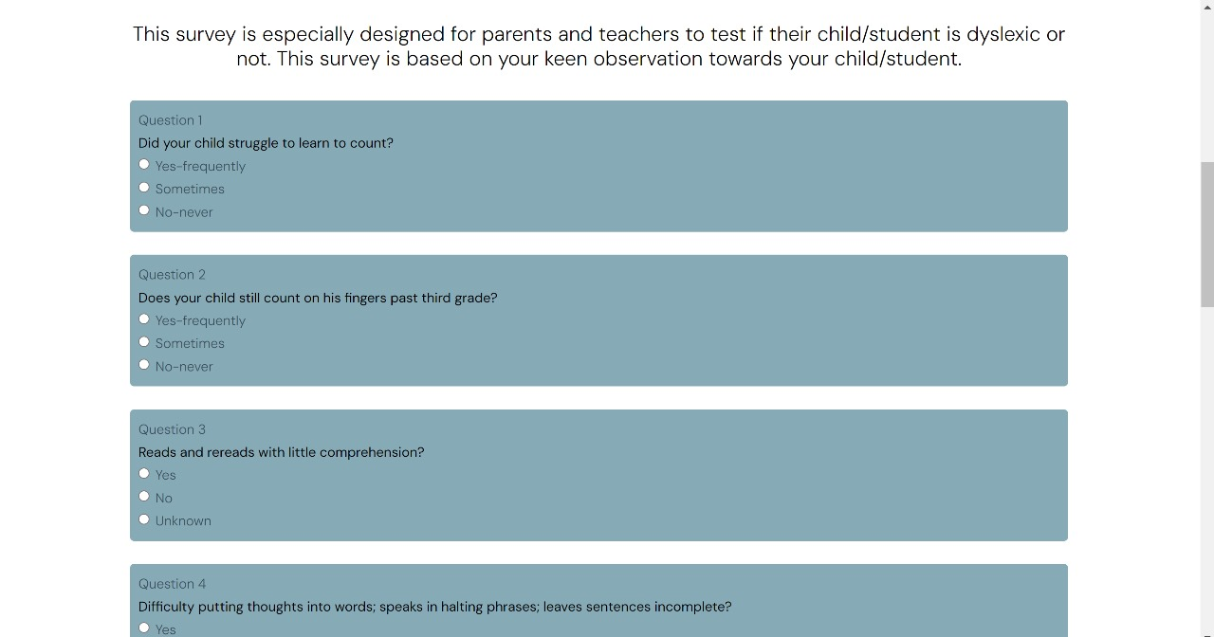

Slide 25
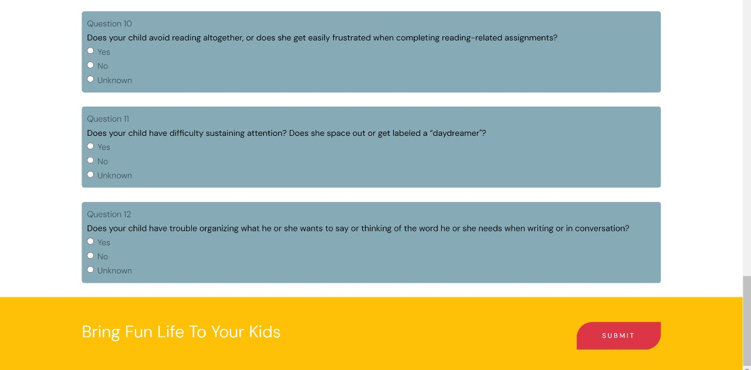

Slide 26


Slide 27
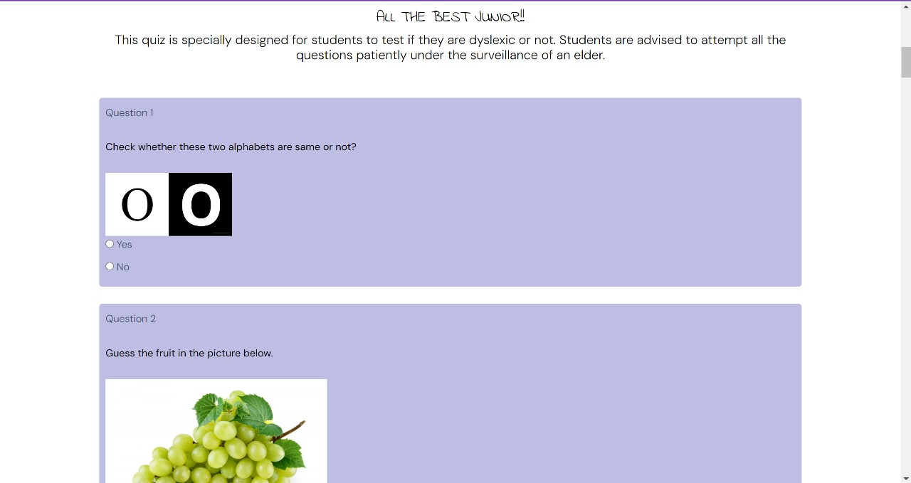

Slide 28
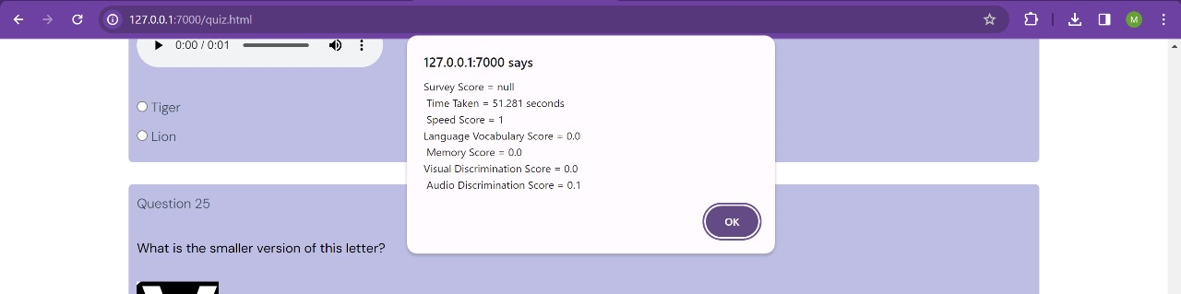

Slide 29


Slide 30
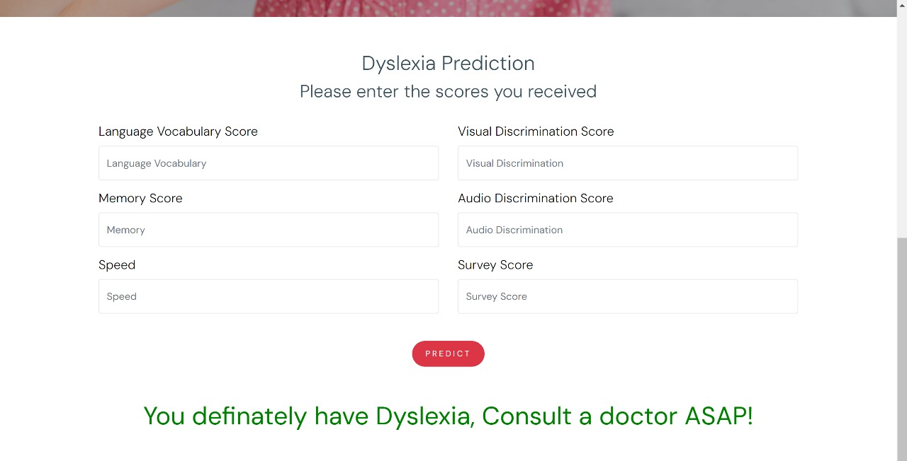

Slide 31
